Slide 1
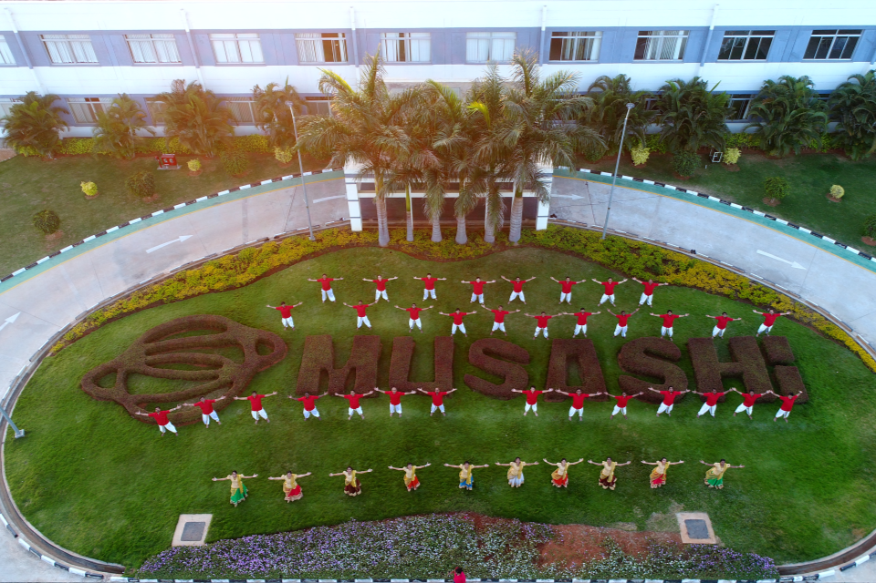
CIRCLE NAME: ACHIEVER
MUSASHI AUTO PARTS INDIA PVT LIMITED
BANGALORE PLANT
ACHIEVER
ACHIEVE THE TARGET WITH CONTINUOUS IMPROVEMENT

Slide 2
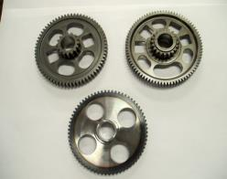
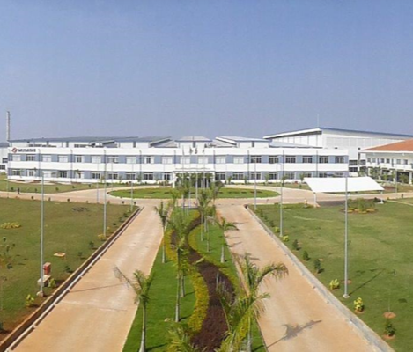
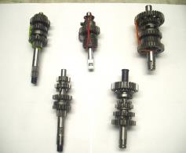
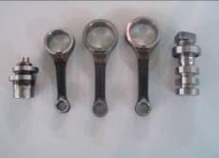
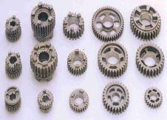
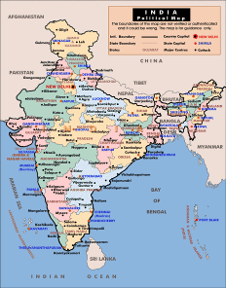
INTRODUCTION TO OUR COMPANY
QUALITY CIRCLE
MAP-ID IS SITUATED IN BENGALURU KARNATAKA.
WE PROCESS FORGINGS, PERFORM MACHINING, HEAT TREATMENT & ASSEMBLY OF CON RODS, CAM SHAFTS, GEARS & SHAFTS

Slide 3
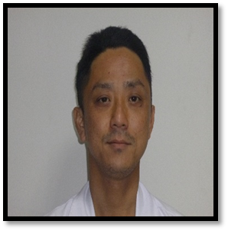


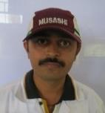

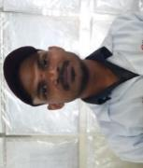
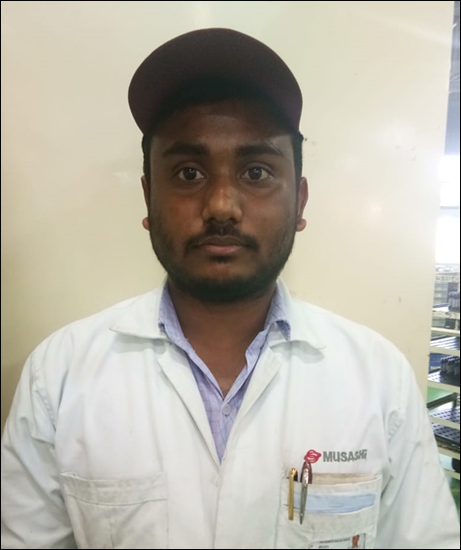
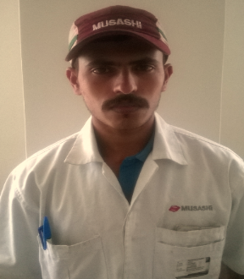

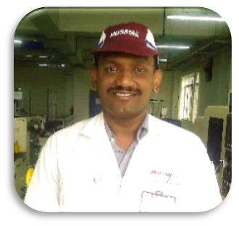
ACHIEVER
TEAM INRTODUCTION
ADVISOR
NAME :YUYA SAN
TEAM LEADER
NAME : SEEMA SAN
DEPT : PROD- ASSLY
TEAM MEMBER
NAME : SUBHASHREE SAN
DEPT : PROD- ASSLY
TEAM MEMBER
NAME : P. KULKERNI SAN
DEPT : PROD- ASSLY
TEAM MEMBER
NAME : SIDAPPA SAN
DEPT : PROD- ASSLY
TEAM MEMBER
NAME : RATIKANT SAN
DEPT : PROD- ASSLY
TEAM SUPPORT
NAME : PRAVEEN SAN
DEPT : ME DEPT
TEAM SUPPORT
NAME : SAJIN SAN
DEPT : PRODUCTION

Slide 4
ACTIVITY SCHEDULE
Sl No | Methodology Steps | Responsibility | P / A | Week Number
 |  |  |  | APRIL-18 |  |  | MAY-18 |  |  | JUNE-18 |  |  | JULY-18
1 | THEME SELECTION | SEEMA SAN | PLAN
 |  |  | ACTUAL
2 | CURRENT SITUATION/ TARGET SETTING | SEEMA SAN | PLAN
 |  |  | ACTUAL
3 | PLAN PREPARATION | SUBHASHREE SAN | PLAN
 |  |  | ACTUAL
4 | CAUSE AND EFFECT ANALYSIS | SUBHASHREE SAN | PLAN
 |  |  | ACTUAL
5 | COUNTERMEASURE STUDY | KULKERNI SAN | PLAN
 |  |  | ACTUAL
6 | COUNTERMEASURE TAKING | KULKERNI SAN | PLAN
 |  |  | ACTUAL
7 | EFFECT CONFORMATION | SIDDAPA SAN | PLAN
 |  |  | ACTUAL
8 | STANDARDIZATION & CONTROL | RATIKANT SAN | PLAN
 |  |  | ACTUAL
9 | HORIZONTAL DEPLOYEMENT | SIDDAPA SAN | PLAN
 |  |  | ACTUAL

Slide 5
THEME SELECTION MATRIX
SCANNING MC PRODUCTIVITY LOW SO WE HAVE TO DEPLOY MANPOWER IN B SHIFT FOR ACHIEVE THE CUSTOMER DEMAND . AS PER MANPOWER PLANNING ONLY A SHIFT MANPOWER GIVEN SO IT IS TAKEN AS OUR THEME.

Slide 6
THEME AND TARGET
SCANNING MC PRODUCTIVITY IMPROVEMENT
SM K67 SCANNING MC OEE MPROVEMENT FROM 66% TO 74%

Slide 7
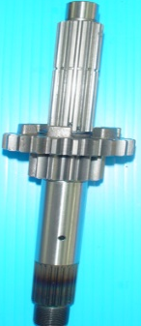
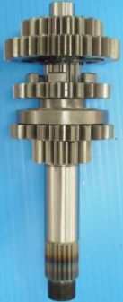
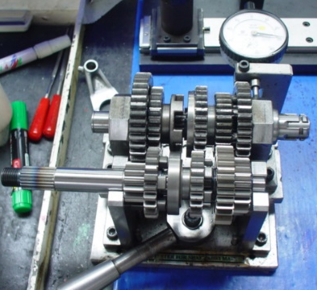
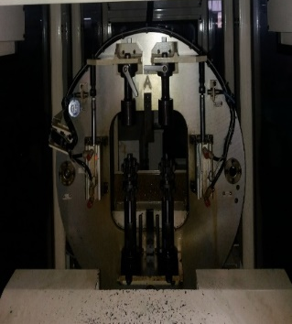
PROCESS FLOW AND CURRENT STATUS ANALYSIS
1ST STATION
2ND STATION
3RD STATION
SCANNING
CURRENT CONDITION ANALYSIS
OUTPUT LESS IN SCANNING MC
WHY
CT SAME BUT OEE LESS
WHY
LOSSES MORE IN OEE DUE TO WAITING TIME MORE & MANAGEMENT LOSS TIME MORE SO OEE NOT ACHIEVING
OEE LESS IN SM K67 SCANNING SO THIS IS TAKEN FOR IMPROVEMENT

Slide 8
ACTIVITY SCHEDULE PLAN
MIQC NAME: ACHIEVER
DEPT; PRODUCTION
FACILITATER;- YUYA SAN
1.SEEMA SAN
2.SUBHASHREE SAN 3.PRAVEEN SAN 4.P.KULKERNI SAN 5.SIDDAPA SAN 6.RATIKANT SAN
3.
PROJECT;- SM K67 PRODUCTIVITY IMPROVEMENT
START MONTH;- MAY-18
END MONTH;- JUL-18
MEMBERS
Meeting time every Friday 3 to 4 pm
NO OF PROJECTS COMPLETED;-1
WE COMPLETED OUR ACTIVITY AS PER THE PLAN

Slide 9



CAUSE AND EFFECT ANALYSIS
PRODUCTIVITY
LESS
MAN
MACHINE
New operator
Fixture design NG
Lack of awareness
Part NG alarm
MC programme NG
Unskilled manpower
Improper setting
Washer fall down
Master part check miss
Waiting time more
Non availability of material for for scanning
Material movement to scanning mc
Dust in part
METHOD
MATERIAL

Slide 10
COUNTERMEAURE STUDY
NO. | SUSPECT | PROBLEM POINT | COUNTERMEASURE | TARGET | STATUS
1. | Waiting time more | Manpower is loading 2 parts in mc & waiting for 3 sec for operation then unloading & rubber band tightening in assly then keeping in output bin then taking another part for scanning so manpower ideal time is 3 sec . | Locator to be provided for Keeping parts after scanning completion then part loading & after that rubber band tightening to be done | 25.06.18
2. | Fixture design NG | Due to bottom fixture design ng ok parts also misjudgment observed | Fixture design to be change | 7.06.18
3. | Material movement delay to scanning mc & operator fatigue is more | For material movement small trolley used so at a time only 6 bin can move for scanning . | Scissor lifter trolley used for scanning material move to scanning mc at a time 18 bin can be move for scanning & operator has picking the part from bin easily by adjusting | 23.05.18
4 | Top Washer found inside machine | Washer fall down | Top fixture design to be change | 25.10.18

Slide 11
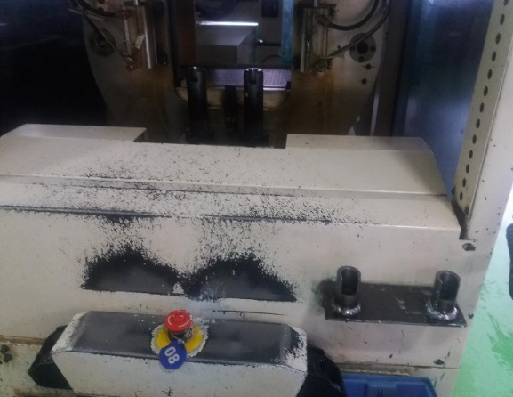

OEE IMPROVEMENT SCANNING MC-810011(by waiting time reduction)
NO. | SUSPECT | PROBLEM POINT | COUNTERMEASURE | TARGET | STATUS
1. | Waiting time more | Manpower is loading 2 parts in mc & waiting for 3 sec for operation then unloading & rubber band tightening in assly then keeping in output bin then taking another part for scanning so manpower ideal time is 3 sec . | Locator to be provide for Keeping parts after scanning completion then part loading & after that rubber band tightening to be done | 25.06.18
BEFORE
PART LOADING
RUBBER BAND TIGHT 2ND PART 1.5 SEC
KEEP IN FG BIN ANTI RUST OIL SPRAY
NEXT PART LOADING
PART CHECK IN MC
RUBBER BAND TIGHT ONE PART 1.5 SEC
MC IDEAL 3 SEC
BEFORE
FIXTURE NOT AVAILABLE
AFTER
PART LOADING
PART CHECK IN MC
PART KEEP IN LOCATOR & NEXT PART LOADING
KEEP IN FG BIN ANTI RUST OIL SPRAY
3 sec mc run after providing the locator
AFTER
RUBBER BAND TIGHT ONE PART 1.5 SEC
RUBBER BAND TIGHT 2ND PART 1.5 SEC
FIXTURE PROVIDED FOR KEEPING PART & LOADING ANOTHER PART
In scanning mc-810011 by providing locator 1.5 sec SAVE FOR 1 COMPONENT & OEE improved from 66% to 76%

Slide 12
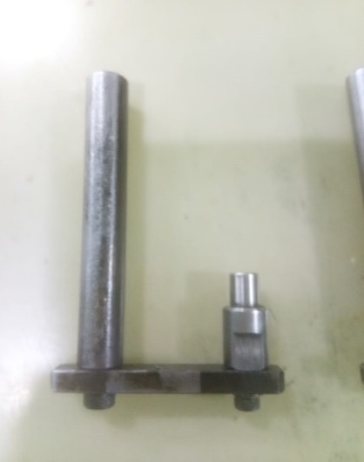
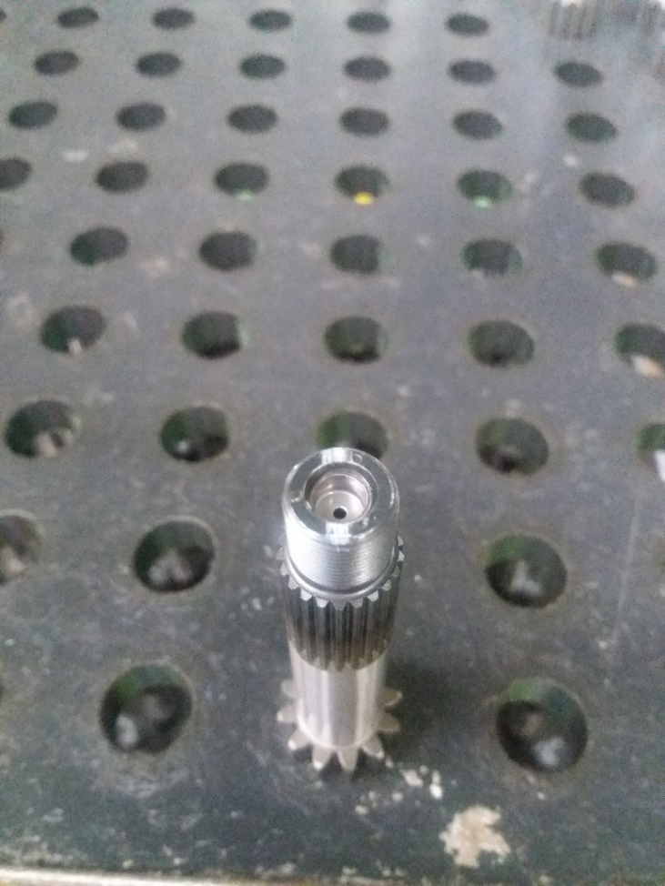
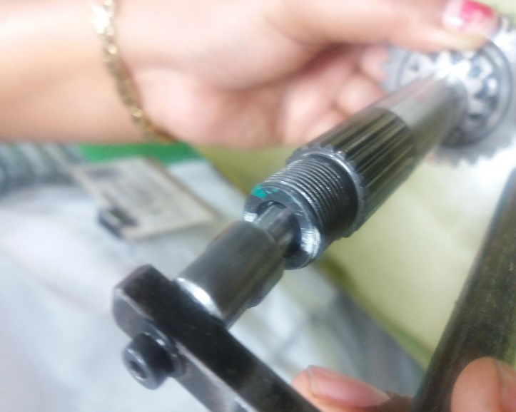
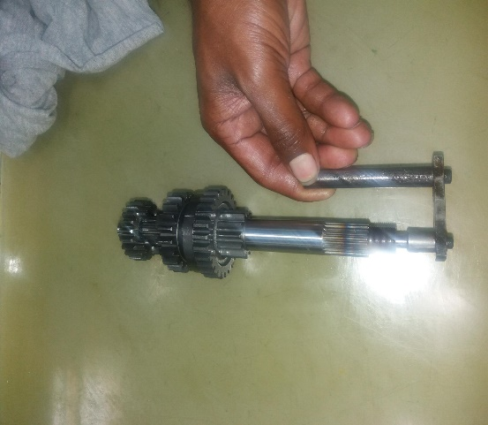
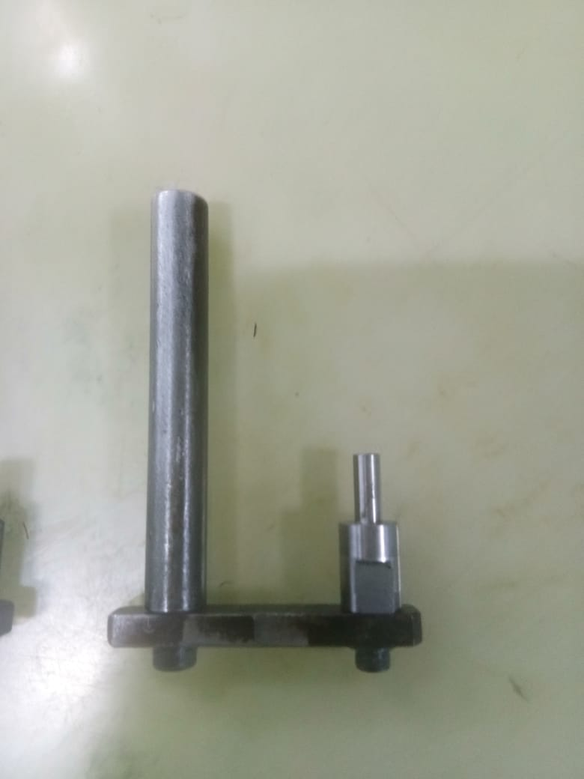
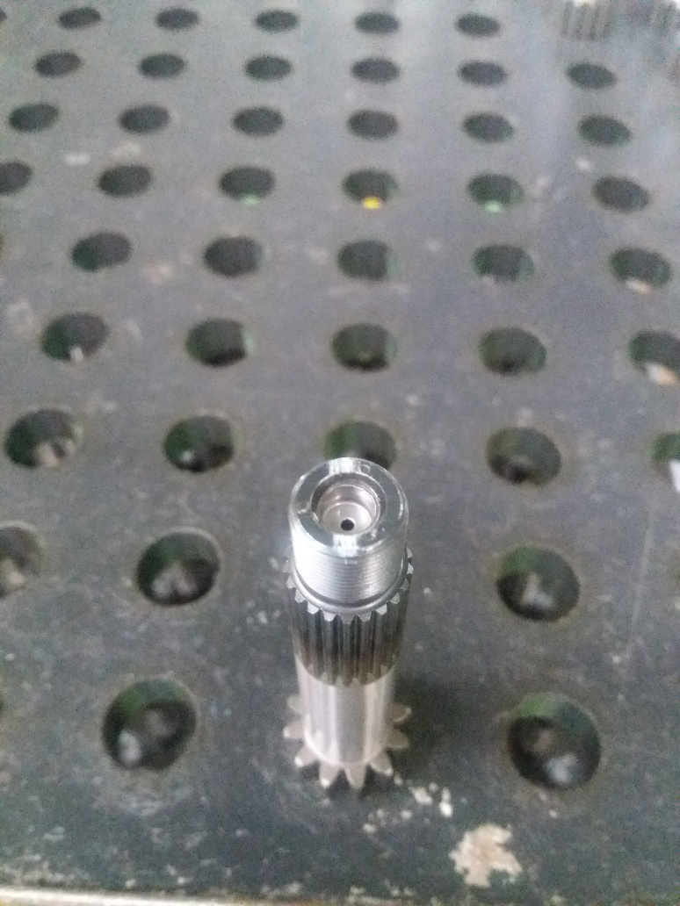
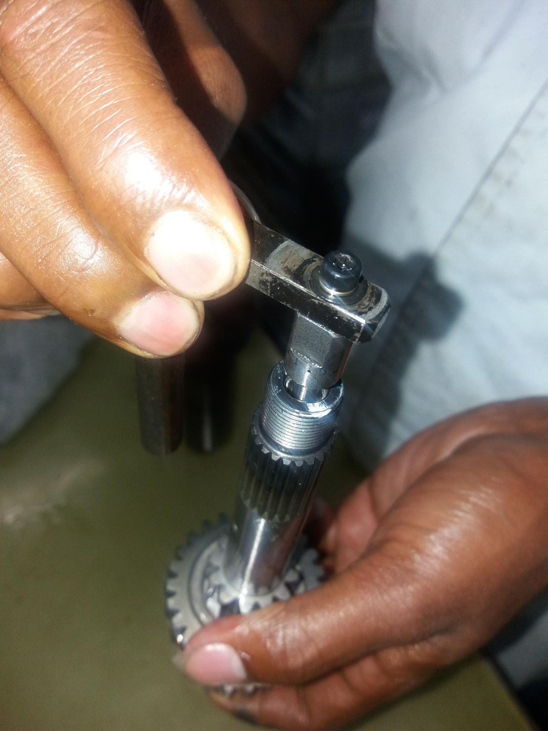
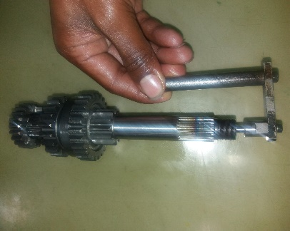
COUNTERMEASURE TAKING
NO. | SUSPECT | PROBLEM POINT | COUNTERMEASURE | TARGET | STATUS
2. | Fixture design NG | Due to bottom fixture design NG , ok parts also showing NG, misjudgment of parts | Fixture design to be change | 7.06.18
BEFORE
PLUG OD FACE
SCANNING MC BOTTOM FIXTURE RESTING ON PLUG OD FACE
DUE TO PLUG FACE UNEVEN RESTING POSITION DISTURB IN SCANNING & SHOWS NG JUDGEMENT
N30 DATA TAKEN: IN OLD PIN 76% NG PART JUDGEMENT OBSERVAED & IN NEW PIN 0% NG PART JUDGEMENT OBSERVED
AFTER
PLUG BOTTOM SURFACE
SCANNING MC BOTTOM FIXTURE RESTING ON PLUG BOTTOM SURFACE
IT LEADS TO PART CLAMPING PROPERLY & NO MOVEMENT
IN SCANNING MC-810011 BY CHANGING THE BOTTOM FIXTURE DESIGN OEE IMPROVED FROM 66% TO 79%

Slide 13
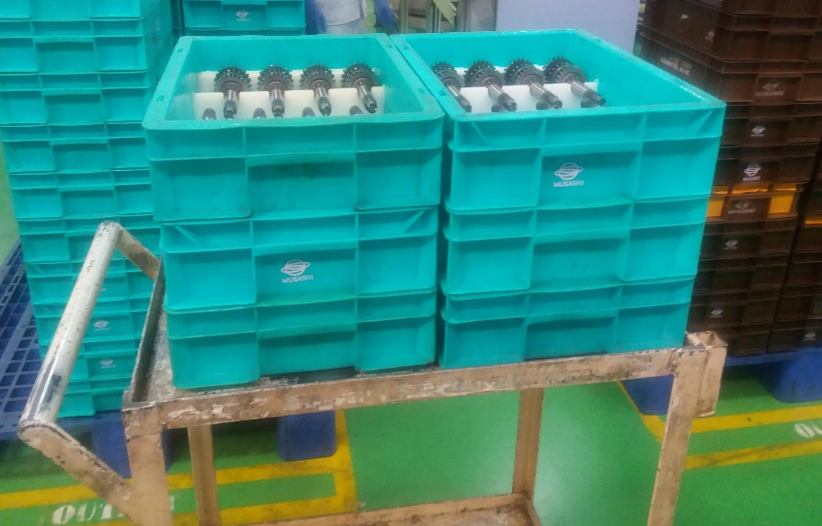
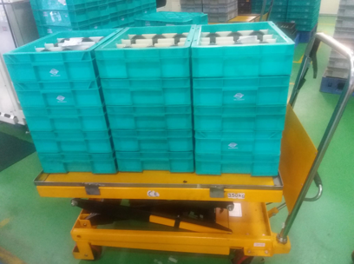
COUNTERMEASURE TAKING
NO. | SUSPECT | PROBLEM POINT | COUNTERMEASURE | TARGET | STATUS
3. | Material movement to scanning mc | For material movement small trolley used so at a time only 6 bin can move for scanning | Scissor lifter trolley used for scanning material move to scanning mc at a time 18 bin can be move for scanning | 23.01.18
BEFORE
AFTER
6 bin can be taken for one time scanning
18 bin can be taken for scanning for one time scanning

Slide 14
Result & Future improvement
Target achieved
NO. | SUSPECT | PROBLEM POINT | COUNTERMEASURE | TARGET | STATUS
4 | Material movement to scanning mc | Washer fall down | Top fixture design to be change-Dowel pin in top fixture to be provide | 25.10.18
OEE NEED TO IMPROVE FURTHER FOR WASHER FALLDOWN PROBLEM RESOLVEMENT.

Slide 15
ACTIVITY SCHEDULE
Sl No | Methodology Steps | Responsibility | P / A | Week Number
 |  |  |  | APRIL-18 |  |  | MAY-18 |  |  | JUNE-18 |  |  | JULY-18
1 | THEME SELECTION | SEEMA SAN | PLAN
 |  |  | ACTUAL
2 | CURRENT SITUATION/ TARGET SETTING | SEEMA SAN | PLAN
 |  |  | ACTUAL
3 | PLAN PREPARATION | SUBHASHREE SAN | PLAN
 |  |  | ACTUAL
4 | CAUSE AND EFFECT ANALYSIS | SUBHASHREE SAN | PLAN
 |  |  | ACTUAL
5 | COUNTERMEASURE STUDY | KULKERNI SAN | PLAN
 |  |  | ACTUAL
6 | COUNTERMEASURE TAKING | KULKERNI SAN | PLAN
 |  |  | ACTUAL
7 | EFFECT CONFORMATION | SIDDAPA SAN | PLAN
 |  |  | ACTUAL
8 | STANDARDIZATION & CONTROL | RATIKANT SAN | PLAN
 |  |  | ACTUAL
9 | HORIZONTAL DEPLOYEMENT | SIDDAPA SAN | PLAN
 |  |  | ACTUAL
Activity completed as per schedule scanning mc fixture drawing standardization is pending target :25.10.2018

Slide 16
THANK YOU

